Slide 1
Central Processing Unit
(Introduction and General Register Organization)
(Lecture 19-21)

Slide 2
Central Processing Unit (CPU)
Central Processing Unit (CPU)
CPU stands for Central Processing Unit. It is the primary component of a computer system responsible for executing instructions of a computer program and performing basic arithmetic, logical, control, and input/output (I/O) operations. Often referred to as the "brain" of the computer, the CPU interprets and processes instructions stored in the computer's memory.
CPU is made up of 3 major parts:
Registers
Control Unit (CU)
ALU(Arithmetic Logic Unit)

Slide 3
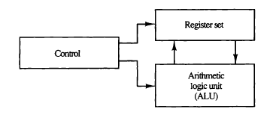
Central Processing Unit (CPU) (Cont..)
Major Components of CPU

Slide 4
Central Processing Unit (CPU) (Cont..)
Main functions of some key components of the CPU:
Control Unit (CU):
Function: Manages and coordinates the operation of the CPU.
Activities:
Fetches instructions from memory.
Decodes instructions to determine the required operations.
Controls the execution of instructions.
Arithmetic Logic Unit (ALU):
Function: Performs arithmetic and logical operations.
Activities:
Handles basic arithmetic operations (addition, subtraction, multiplication, division).
Executes logical operations (AND, OR, NOT).
Compares values.

Slide 5
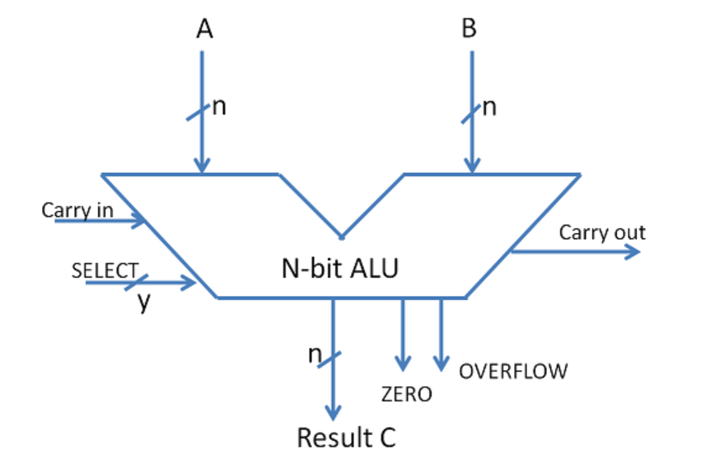
Central Processing Unit (CPU) (Cont..)
ALU Symbol
3. Registers (A set of flip-flops forms a register):
Function: Temporary storage for data during processing.
Activities:
Holds operands and intermediate results.
Provides fast access to data for the CPU.
Facilitates data movement within the CPU.

Slide 6
General Register Organization
When a large number of registers are included in the CPU, it is most efficient to connect them through a common bus system. The registers communicate with each other not only for direct data transfers, but also while performing various microoperations. Hence it is necessary to provide a common unit that can perform all the arithmetic, logic, and shift microoperations in the processor.
A bus organization for seven CPU registers is shown in next Fig. in which outputs of each register is connected to two multiplexers (MUX) to form the two buses A and B. The selection lines in each multiplexer select one register or the input data for the particular bus. The A and B buses form the inputs to a common arithmetic logic unit (ALU).

Slide 7
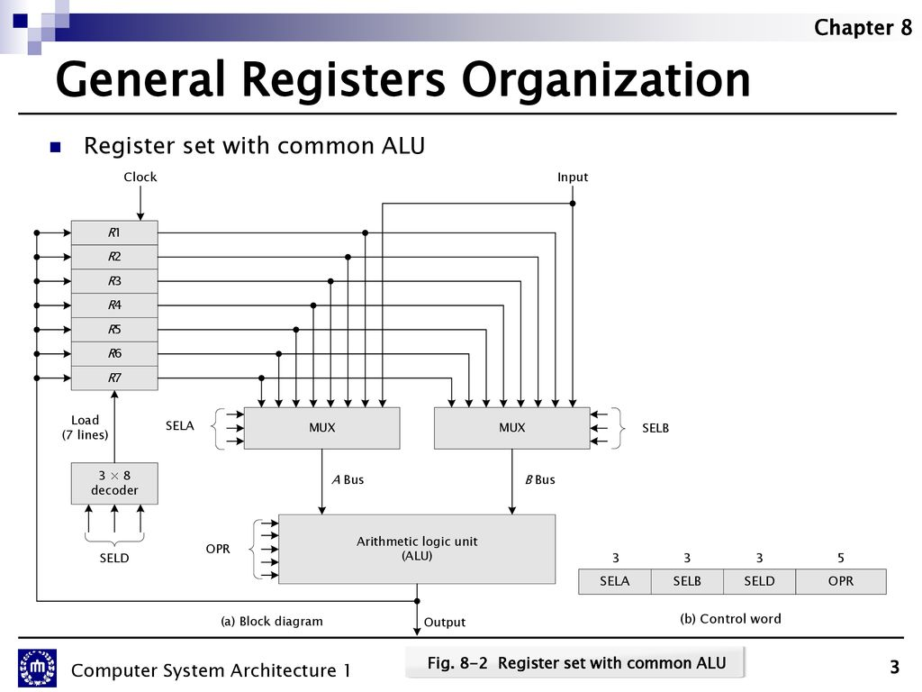
General Register Organization (Cont..)

Slide 8
General Register Organization (Cont..)
The operation selected in the ALU determines the arithmetic or logic microoperation that is to be performed. The result of the microoperation is available for output data and also goes into the inputs of all the registers. The register that receives the information from the output bus is selected by a decoder. The decoder activates one of the register load inputs, thus providing a transfer path between the data in the output bus and the inputs of the selected destination register. The control unit that operates the CPU bus system directs the information flow through the registers and ALU by selecting the various components in the system.

Slide 9
General Register Organization (Cont..)
For example, to perform the operation R1<--R2 + R3,
the control must provide binary selection variables to the following selector inputs:
MUX A selector (SELA): to place the content of R2 into bus A.
MUX B selector (SELB): to place the content of R3 into bus B.
ALU operation selector (OPR): to provide the arithmetic addition A+ B.
Decoder destination selector (SELD): to transfer the content of the output bus into R 1.

Slide 10
General Register Organization (Cont..)
Control Word:-
There are 14 binary selection inputs in the unit, and their combined value specifies a control word. 14-bit control word when applied to the selection inputs specify a particular microoperation.
It consists of four fields. Three fields contain three bits each, and one field has five bits.
The three bits of SELA select a source register for the A input of the ALU.
The three bits of SELB select a register for the B input of the ALU. The three bits of SELD select a destination register using the decoder and its seven load outputs.
The five bits of OPR select one of the operations in the ALU.

Slide 11
General Register Organization (Cont..)
Encoding of Register Selection Field
Binary Code | SELA | SELB | SELD
000 | Input | Input | None
001 | R1 | R1 | R1
010 | R2 | R2 | R2
011 | R3 | R3 | R3
100 | R4 | R4 | R4
101 | R5 | R5 | R5
110 | R6 | R6 | R6
111 | R7 | R7 | R7

